Slide 1
Hacker blinder
Maze runner

Slide 2
TABLE OF crew
1
02
03
04
Omar Hussam
Rawan Ramdan
Youmna Esmat
Mahmoud Ahmed
Pasant Saad Hemida

Slide 3
INTRODUCTION
In this project, our goal is to create a maze runner robot that enters any maze and leaves it as fast as possible in the most efficient way. To create this, we had to use several instruments, including the Arduino board and software as the main instrument. The Arduino software is based on the C programming language which will enable us to program our robot. We gain many skills.

Slide 4
Maze runner
Main component
Arduino
motor shield
ultra sonic sensor
wheel for motor
lithium battery

Slide 5
The main titles
1-stimulation (thinker cad)
2-talk about code
3-our robot
4-Future Work and Suggestions

Slide 6
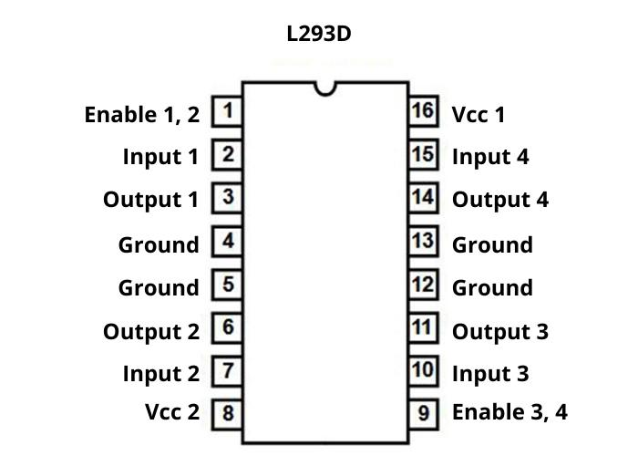
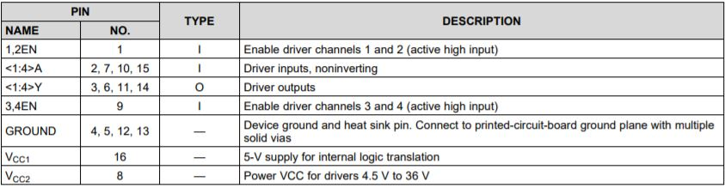
Dashboard thinker cad
We use dashboard thinker cad to be able to simulate our robot, before making it. Simulation helps us as designers to imagine, design, and make anything. thus, we use it before working on our robot.
1- l293D and its connection:

Slide 7
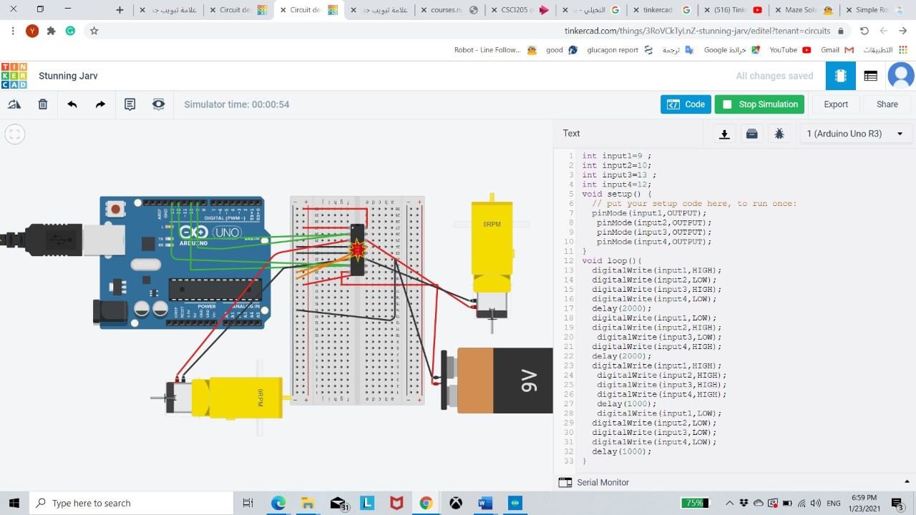
2-secondly, I connect Arduino with a motor shield (L293D) and two motor and outer source batteries to supply the internal motor.

Slide 8
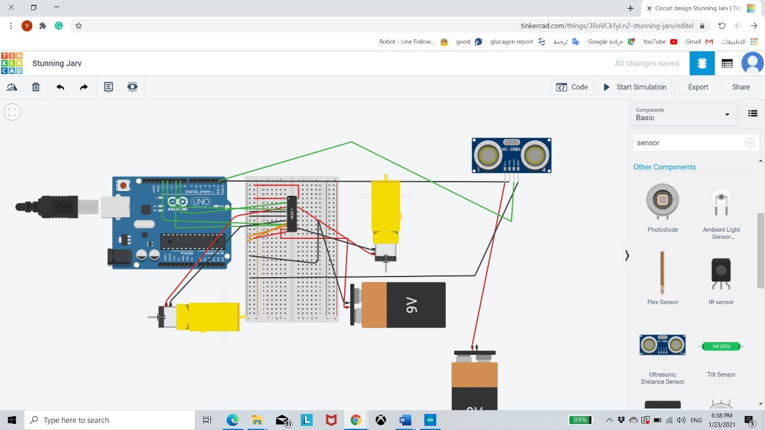
3- Third, I connect Arduino with a motor shield (L293D) and two motor and outer source battery to supply internal motor, an ultra-sonic sensor connects them with each

Slide 9
Our code
At first, we include the library we need which is the AFMotor.h then we define our pin variables for the sensors, two for each sensor. Then we declare our calculation variables for the sensors then the motor variables then we declare all of our functions that we’ll be using. Then we move on to the setup function for the Arduino where we declare the input and output pins. Moving on to the loop function where the program gets executed repeatedly. In that part we call all of our functions which we want to get executed repeatedly, in our case, the detection of the obstacles and the movement for our robot. Moving to the definition of the functions. First, we have the movement functions which basically takes the motor variables and set them to a certain speed, then tells them which direction they’ll be moving, whether it’s forward or backward. Lastly, we have the sensor functions which takes an int in CMs and checks whether the detected obstacle is closer or equals that distance entered to the function.

Slide 10

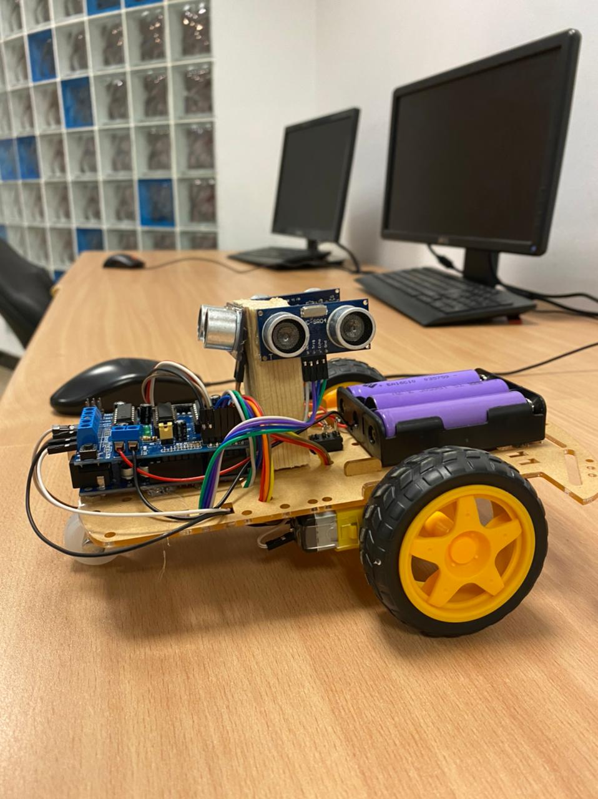
ARDUINO UNO
MOTOR SHIELD
SENSORS
BATTARY
DC MOTORS

Slide 11
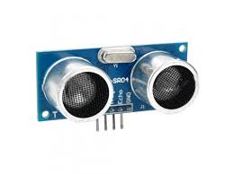
ultrasonic sensor

Slide 12
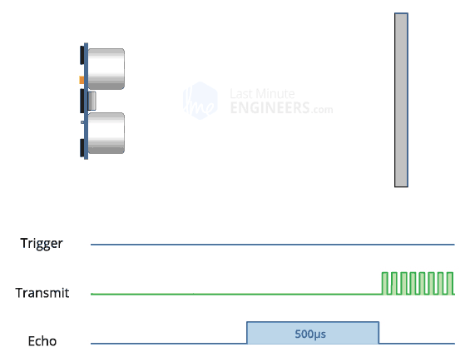
An ultrasonic sensor is an electronic device that measures the distance of a target object by emitting ultrasonic sound waves and converts the reflected sound into an electrical signal. Ultrasonic waves travel faster than the speed of audible sound. In our code, we define our pin variables for the sensors, two for each sensor, one for trigPinLeft which it emitted wave and echoPinLeft, and the other to detector the wave. In order to calculate the distance between the sensor and the object, we use this formula for this calculation is distance left = duration left*0.034/2. If he detects an object it will return true, then the robot starts to take an action. Then we start to do a loop to check if the sensor detected obstacle is closer or equals if there, it will start to take an action according to that table.
Detect something in | And another detection | Do that order
Left () | Front () | Right ()
Right () | Front () | Left ()
Front () | Right () && Left () | Freeze ()
 |  | Forward ()

Slide 13
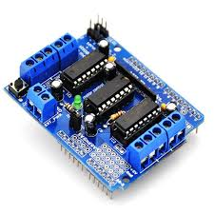
MOTOR SHIELD

Slide 14

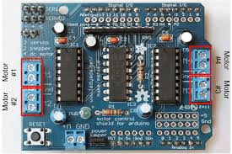
It lets you drive two DC motors with your Arduino board, controlling the speed and direction of each one independently. You can also measure the motor current absorption of each motor, among other features. The shield is TinkerKit compatible, which means you can quickly create projects by plugging TinkerKit modules to the board.

Slide 15
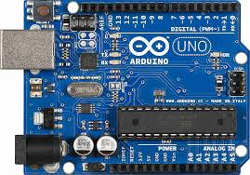
ARDUINO UNO

Slide 16

ARDUINO UNO
We used the Arduino uno too implies the code that we wrote with the hardware object and test it. To connect the Arduino uno with the other parts like the motors, sensors, and battery we used the motor shield. Putting the motor shield over the Arduino to let us have more ground and volts pins to use. This helps us to use more sensors and also two motors and help to control its speed and their direction. A battery and switch to open and close the battery bower.

Slide 17
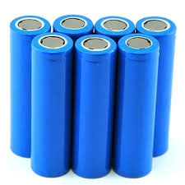
lithium battery

Slide 18

The basic operation of all these designs is similar. A current carrying conductor is placed in a magnetic field and applying power through these conductors causes motor rotation. The difference among the designs is how the electromagnetic fields are generated and where in either the rotor or stator.

Slide 19

Future Work and Suggestions:

Slide 20
we have a lot of ideas for future work.
Firstly, install a camera to detect the map before entering the maze, and solve it using algorithms, and take the shortest way to the end.
Secondly, install the memory module in the robot to save the short way of the maze when we put it in the first attempt, then in the second attempt, it will take the short way, in case that the camera doesn't work.
Thirdly, we also can make it move using a remote control, and use it to enter the maze, and solve it by ourselves.
Finally, we can also improve the board, and make it smaller to fit inside small mazes, and use more high-quality components to make it more efficient in a tall maze.

Slide 21

Final result

Slide 22

Thanks for watching

